Slide 1
Machine Learning in R
From: GradQuant
Host: Michael Remington (He/Him)

Slide 2

What is Machine Learning?
An algorithm that learns patterns from data without being explicitly programmed to know what the patterns are.
Often used to:
make predictions
classify data
cluster data
attain insights and find patterns in data
Notes:
You train the model
Examples of machine learning in real world include speech recognition, facial recognition, search recommendations, detect fraud and many others!

Slide 3
Types of Machine Learning
Supervised
Semi-Supervised
Unsupervised
Labeled inputs and outputs
User trains a machine learning algorithm
Used to classify or regress make predictions
Better for learning about the data and is more descriptive
SVD, Random forests, regression
Inconsistent labeled data,
Small training set
Unlabeled data
Find structures and patterns underlying in the data
Clustering, associations, dimension reduction
Can be sort of a black box
PCA, kmeans, Neural Networks

Slide 4
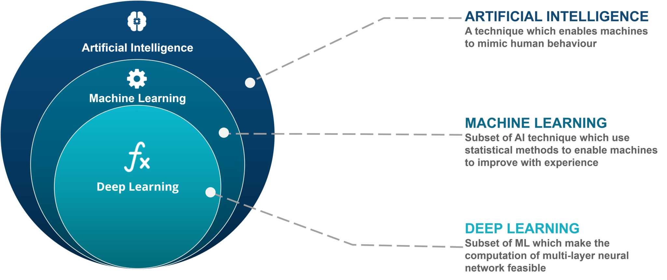
Machine Learning vs Deep Learning

Slide 5
ML workflow
Exploratory Data Analysis
Manage Missing Data
Split Data into training and test data
Train your model(s)
Evaluate model performance
Compare model performance

Slide 6

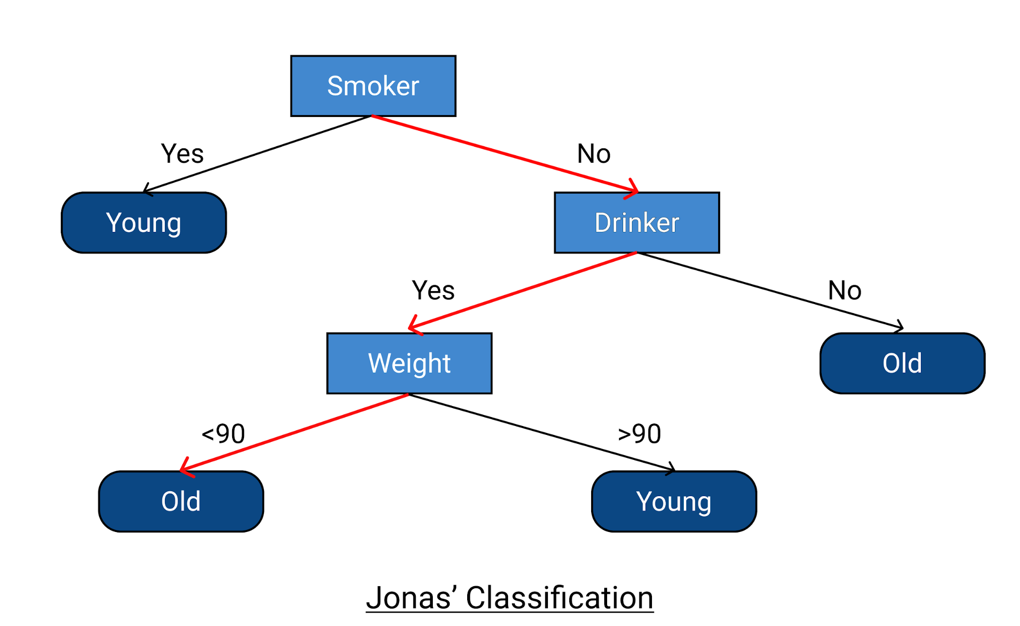
Random Forest Models
Tree Image: https://www.britannica.com/plant/Douglas-fir
Decision Tree Image: https://www.upgrad.com/blog/decision-tree-in-machine-learning/

Slide 7
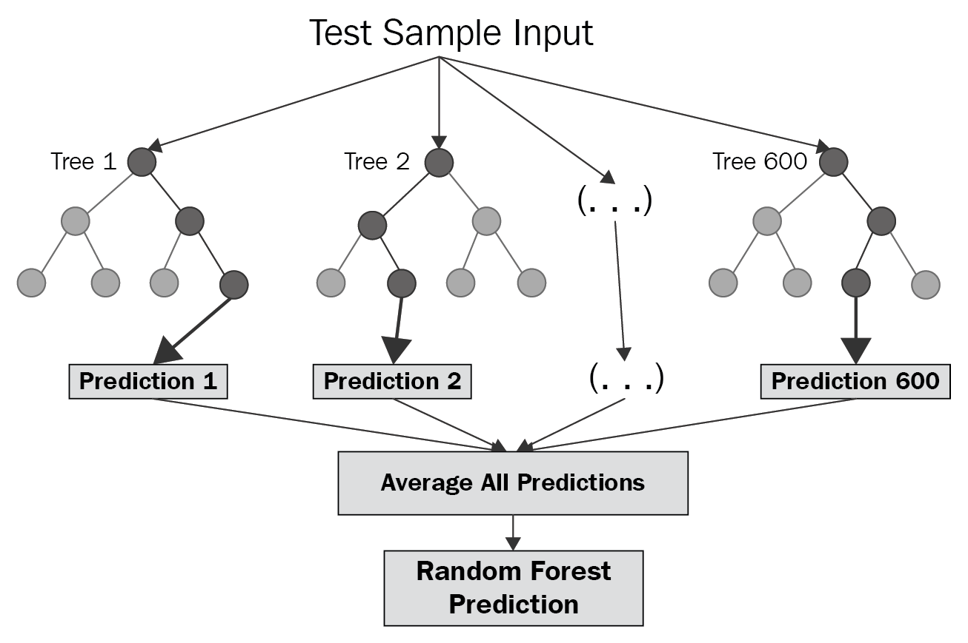

Random Forest Models
Images from:https://medium.com/swlh/random-forest-and-its-implementation-71824ced454f

Slide 8
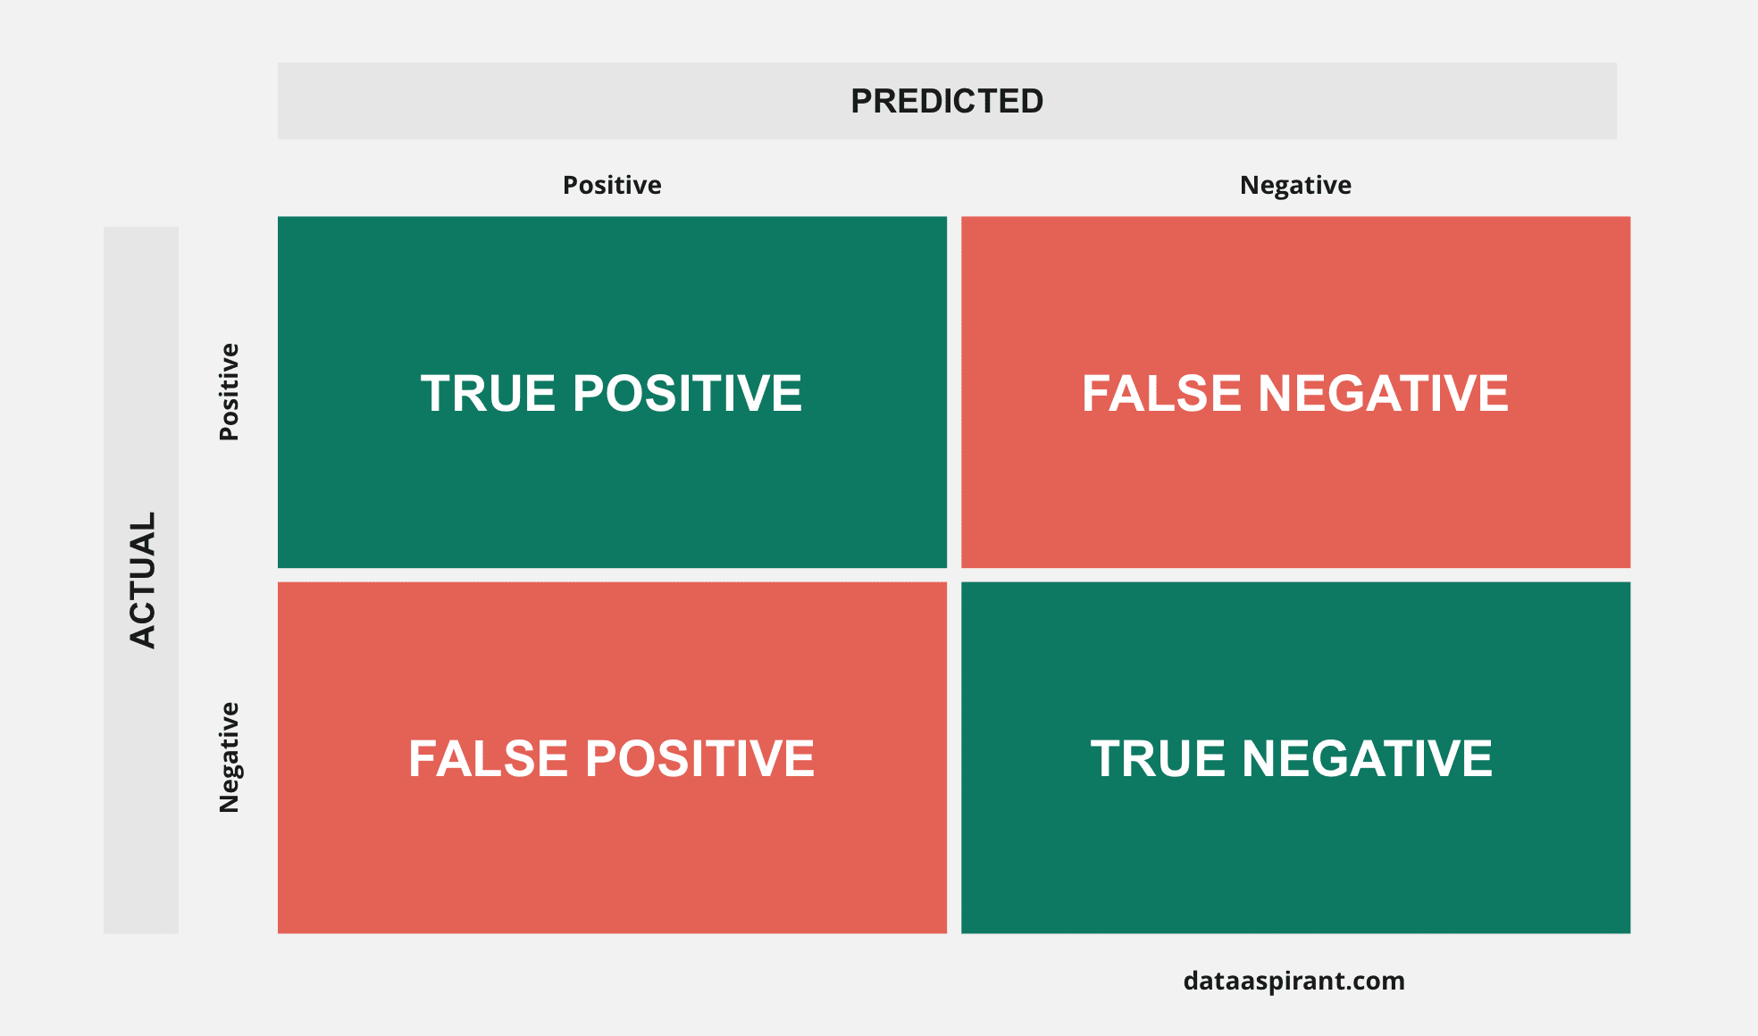
Classification performance metrics
OOB: Out of Bag Error Rate
The percentage of labels that were incorrectly guessed by our model
The goal is as close to 0% as possible
Classification Types
True Positive
True Negative
False Positive
False Negative

Slide 9
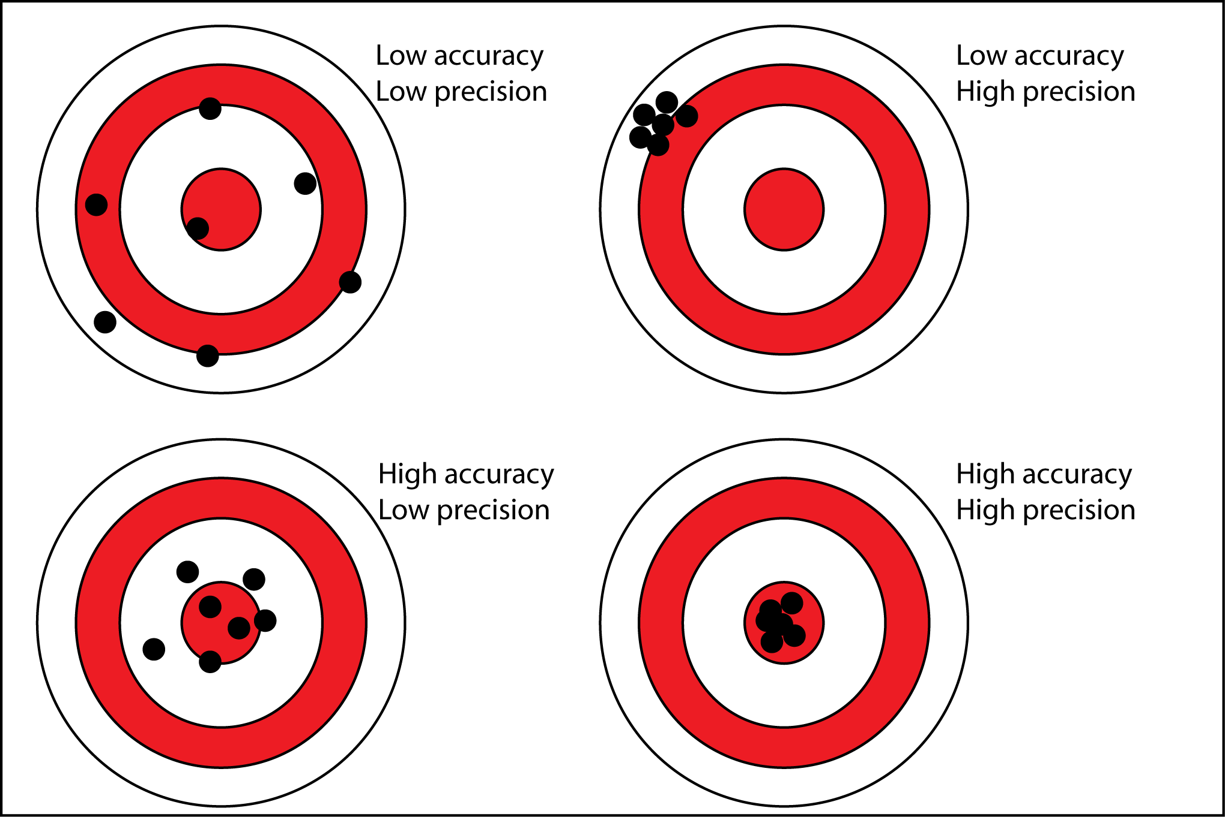
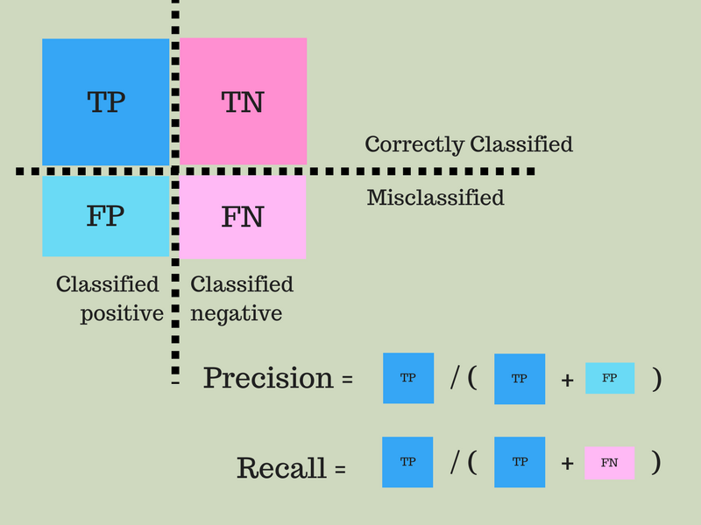
Accuracy, Precision, Recall

Slide 10
ROC and AUC
Sensitivity: The probability that the model predicts a positive outcome for an observation when the outcome is indeed positive.
Specificity: The probability that the model predicts a negative outcome for an observation when the outcome is indeed negative.

